Slide 1


INTRODUCTION
TO COMPUTER
VISION
With Microsoft Azure

Slide 2

INTRODUCTION
Computer Vision is an area of AI that deals with visual processing

Slide 3
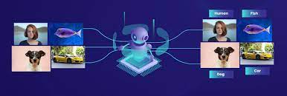

IMAGE CLASSIFICATION
Image classification involves training a machine learning model to classify images based on their contents

Slide 4
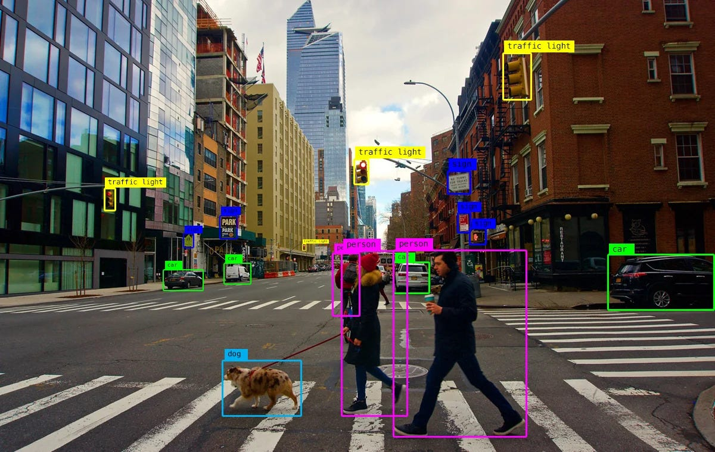
OBJECT DETECTION

Slide 5
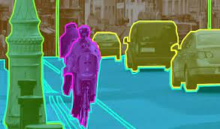
SEMANTIC SEGMENTATION

Slide 6
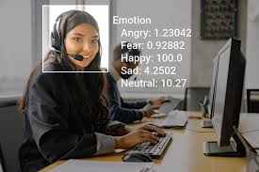
You can create solutions that combine machine learning models with advanced image analysis techniques to extract information from images, including "tags" that could help catalog the image or even descriptive captions that summarize the scene shown in the image.
IMAGE ANALYSIS

Slide 7
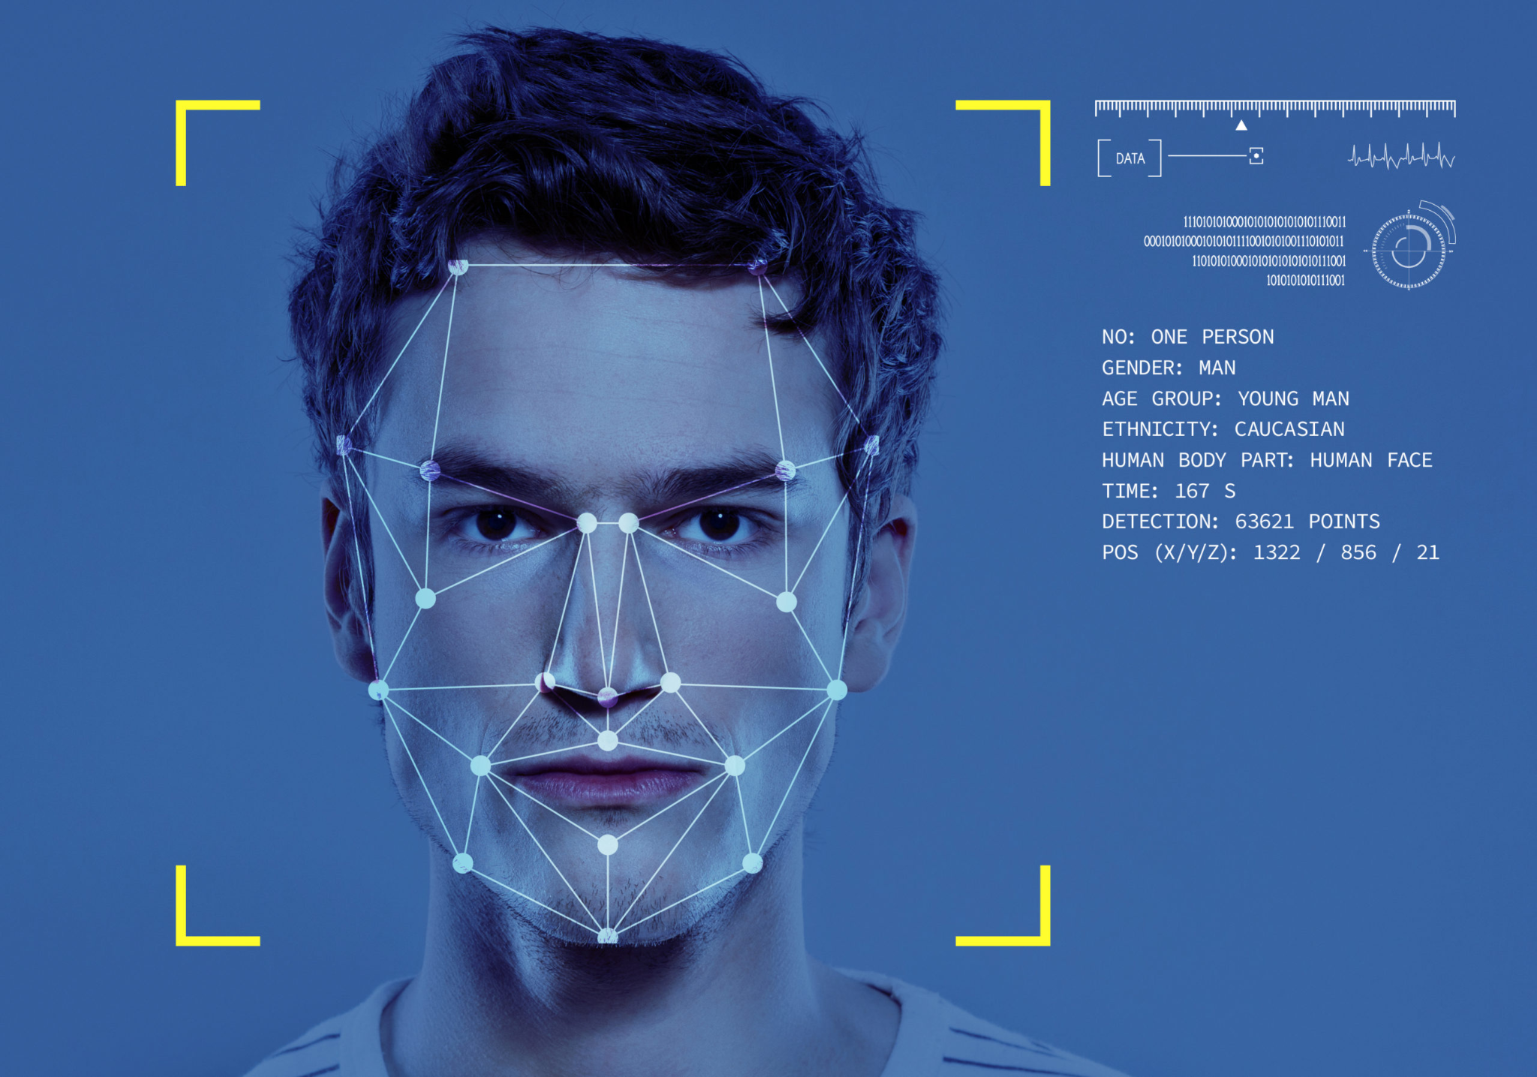
FACE DETECTION,
ANALYSIS AND
RECOGNITION

Slide 8
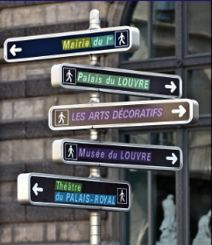
OPTICAL CHARACTER RECOGNITION
Mairie du 1er
Musee du LOUVRE

Slide 9
MICROSOFT AZURE COMPUTER VISION SERVICES
Azure AI Vision
Azure AI Custom Vision
Azure AI Face
Azure AI Document Intelligence

Slide 10

STAY CONNECTED
Do follow our Socials:
Website: vitchennai.acm.org
LinkedIn: ACM VITC
Instagram: acm_vitcc

Slide 11
THANK YOU!
Please, keep this slide for attribution.

